Slide 1

Top Information Per Starver : Restaurant Reviews in Yelp
Group- 0502-03
Amal Byju, Chunghao Lee, Yudong Lu, Rachel Pothen
December 3rd, 2021

Slide 2
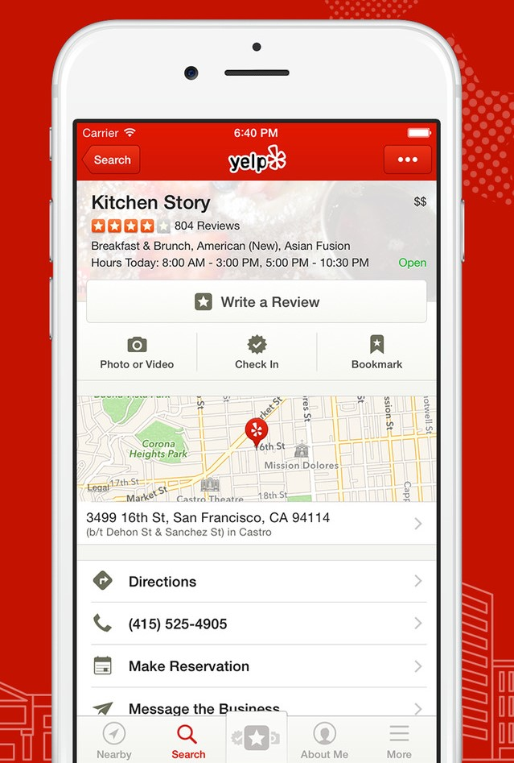
What is Yelp?
Online directory for discovering local businesses ranging from
bars, restaurants, and cafes to hairdressers, spas, and gas stations.
TIPS project utilizes the Yelp dataset and provides analysis for
the benefit of prospective entrepreneurs, reviewers, food
enthusiasts and the general public.
Using Yelp, individuals can check out the reviews, rating and
menu of a restaurant before visiting it which helps them decide if
they want to visit the restaurant.

Slide 3
Mission Statement
To analyse user reviews, ratings, posts and tags for different restaurants on Yelp website. To build insights on user preferences, popular restaurants by category, rating distributions and so on.

Slide 4
Mission Objectives
Find the top 5 highest rated restaurants in each category.
Find the top 5 highest rated restaurants in each price range.
Find the number of 1-star, 2-star, 3-star, 4-star and 5-star reviews for a chosen restaurant.
Find the number of 1-star, 2-star, 3-star, 4-star and 5-star reviews for a chosen user.
Find the top 5 most popular collections.

Slide 5
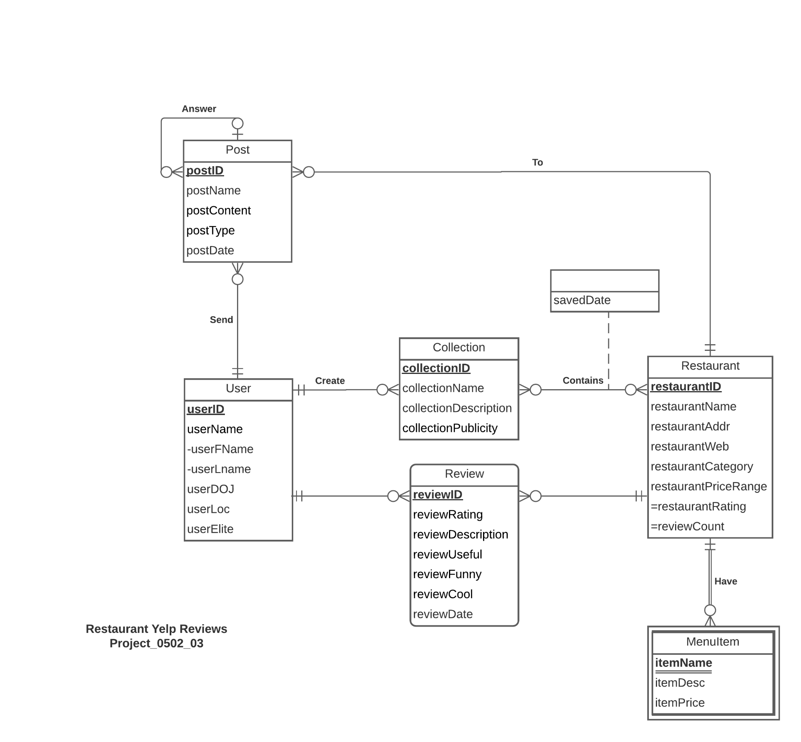
ER Diagram

Slide 6
Logical Database Design
RELATIONAL SCHEMA
User(userID, userFName, userLName, userDOJ, userLoc, userElite)
Restaurant (restaurantID, restaurantName, restaurantAddr, restaurantWeb, restaurantCategory, restaurantPriceRange)
Review(reviewID, reviewRating, reviewDescription, reviewUseful, reviewFunny, reviewCool, reviewDate, userID, restaurantID)
MenuItem(restaurantID, itemName, itemDesc, itemPrice)
Collection (collectionID, collectionName, collectionDescription, collectionPublicity, userID)
Post (postID, postName, postContent, postType, postDate, userID, restaurantID, questionID)
Contains(collectionID, restaurantID, savedDate)

Slide 7
Physical Database Design
CREATE TABLE [TIPS.User] (
userID CHAR(9) NOT NULL,
userFName VARCHAR(20),
userLName VARCHAR(20),
userDOJ DATE,
userLoc CHAR(20),
userElite BIT,
CONSTRAINT pk_User_userID PRIMARY KEY (userID)
)

Slide 8
Physical Database Design
CREATE TABLE [TIPS.Restaurant] (
restaurantID CHAR(9),
restaurantName VARCHAR(50),
restaurantAddr VARCHAR(20),
restaurantWeb VARCHAR(50),
restaurantCategory VARCHAR(30),
restaurantPriceRange VARCHAR(3),
CONSTRAINT pk_Restaurant_restaurantID PRIMARY KEY (restaurantID)
)

Slide 9
Physical Database Design
CREATE TABLE [TIPS.Review] (
reviewID CHAR(9) NOT NULL,
reviewRating INTEGER,
reviewDescription VARCHAR(300),
reviewUseful INTEGER,
reviewFunny INTEGER,
reviewCool INTEGER,
reviewDate DATE,
userID CHAR(9),
restaurantID CHAR(9),
CONSTRAINT pk_Review_reviewID PRIMARY KEY (reviewID),
CONSTRAINT fk_Review_userID FOREIGN KEY (userID)
REFERENCES [TIPS.User] (userID)
ON DELETE CASCADE ON UPDATE CASCADE
CONSTRAINT fk_Review_restaurantID FOREIGN KEY (restaurantID)
REFERENCES [TIPS.Restaurant] (restaurantID)
ON DELETE CASCADE ON UPDATE CASCADE
)

Slide 10
Physical Database Design
CREATE TABLE [TIPS.MenuItem] (
restaurantID CHAR(9) NOT NULL,
itemName VARCHAR(50) NOT NULL,
itemDesc VARCHAR(300),
itemPrice DECIMAL(5,2)
CONSTRAINT pk_MenuItem_restaurantID_itemName PRIMARY KEY (restaurantID, itemName),
CONSTRAINT fk_MenuItem_restaurantID FOREIGN KEY (restaurantID)
REFERENCES [TIPS.Restaurant] (restaurantID)
ON DELETE CASCADE ON UPDATE CASCADE
)

Slide 11
Physical Database Design
CREATE TABLE [TIPS.Collection] (
collectionID CHAR(9) NOT NULL,
collectionName VARCHAR(30),
collectionDescription VARCHAR(150),
collectionPublicity INTEGER,
userID CHAR(9),
CONSTRAINT pk_Collection_collectionID PRIMARY KEY (collectionID),
CONSTRAINT fk_Collection_userID FOREIGN KEY (userID)
REFERENCES [TIPS.User] (userID)
ON DELETE CASCADE ON UPDATE CASCADE
)

Slide 12
Physical Database Design
CREATE TABLE [TIPS.Post] (
postID CHAR(9) NOT NULL,
postName VARCHAR(30),
postContent VARCHAR(300),
postType CHAR(1),
postDate DATE,
userID CHAR(9),
restaurantID CHAR(9),
questionID CHAR(9),
CONSTRAINT pk_Post_postID PRIMARY KEY (postID),
CONSTRAINT fk_Post_userID FOREIGN KEY (userID)
REFERENCES [TIPS.User] (userID)
ON DELETE CASCADE ON UPDATE CASCADE,
CONSTRAINT fk_Post_restaurantID FOREIGN KEY (restaurantID)
REFERENCES [TIPS.Restaurant] (restaurantID)
ON DELETE CASCADE ON UPDATE CASCADE,
CONSTRAINT fk_Post_questionID FOREIGN KEY (questionID)
REFERENCES [TIPS.Post] (postID)
ON DELETE NO ACTION ON UPDATE NO ACTION
)

Slide 13
Physical Database Design
CREATE TABLE [TIPS.Contains] (
collectionID CHAR(9) NOT NULL,
restaurantID CHAR(9) NOT NULL,
savedDate DATE,
CONSTRAINT pk_Contains_collectionID_restaurantID PRIMARY KEY (collectionID, restaurantID),
CONSTRAINT fk_Contains_collectionID FOREIGN KEY (collectionID)
REFERENCES [TIPS.Collection] (collectionID)
ON DELETE CASCADE ON UPDATE CASCADE,
CONSTRAINT fk_Contains_restaurantID FOREIGN KEY (restaurantID)
REFERENCES [TIPS.Restaurant] (restaurantID)
ON DELETE CASCADE ON UPDATE CASCADE
)

Slide 14
Use Case and Application

Slide 15
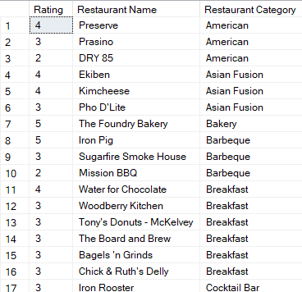
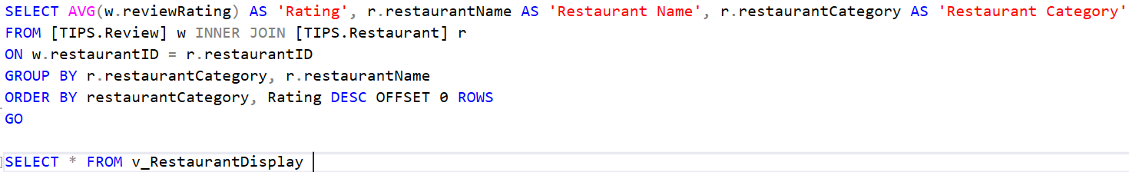
What are the restaurants in each category in decreasing order of Rating

Slide 16
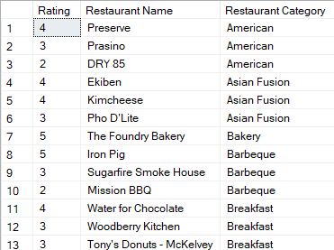
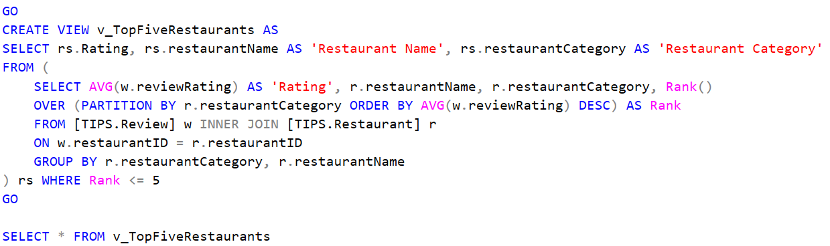
What are top 5 restaurants in each category
in decreasing order of rating.

Slide 17
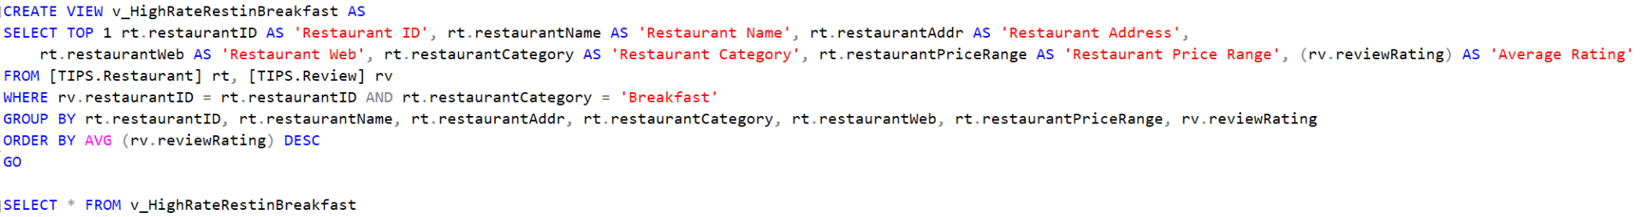
What is the highest rated restaurant in the breakfast category

Slide 18
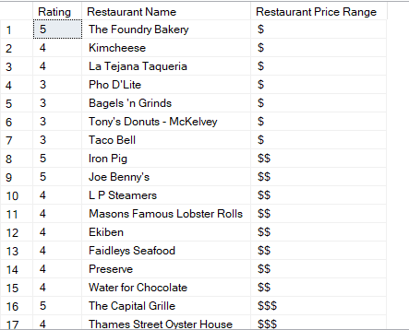
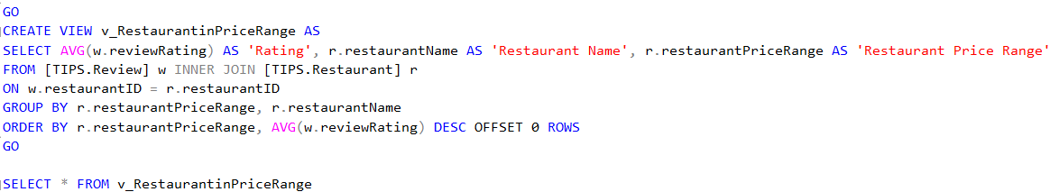
Display restaurants in each price range in decreasing order of rating

Slide 19
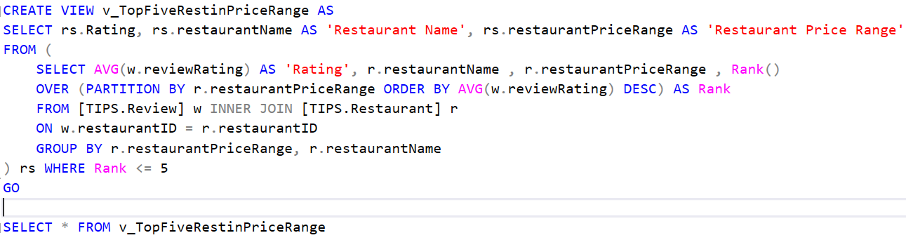
What are the top five restaurants in each price range in decreasing order of rating

Slide 20
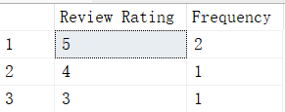
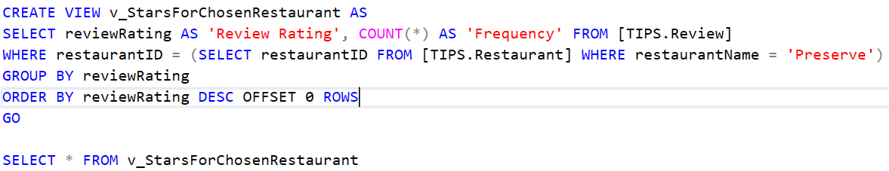
What are the number of 1-star, 2-star, 3-star, 4-star and 5-star reviews for a chosen restaurant.
--In this case, we have chosen 'Preserve' restaurant.

Slide 21
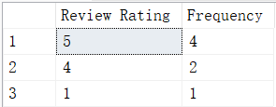
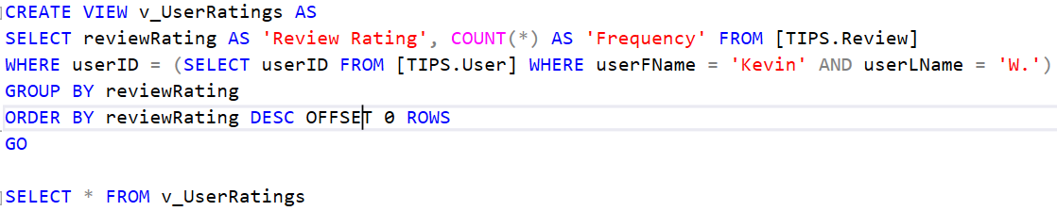
What are the number of 1-star, 2-star, 3-star, 4-star and 5-star reviews for a chosen user.
--In this case, we have chosen 'Kevin W.' as the user.

Slide 22
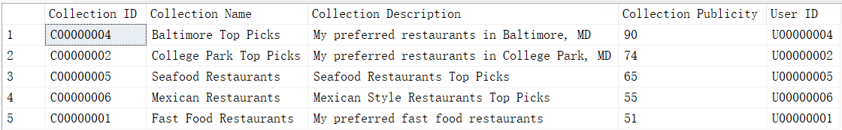
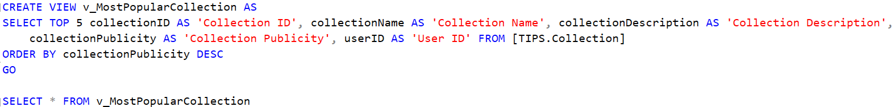
What are the top 5 most popular collections.

Slide 23
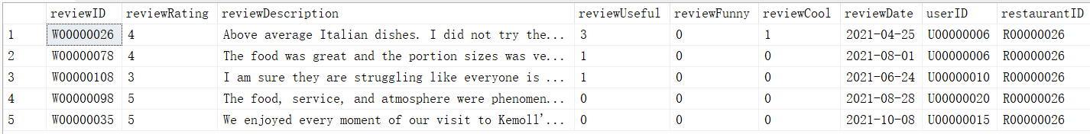
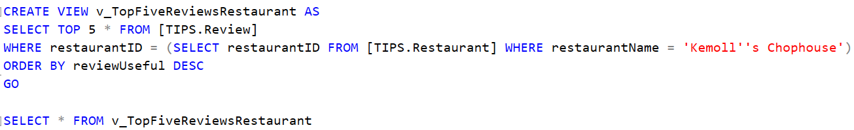
What are the top 5 most useful reviews for a chosen restaurant. In this case, we have
--chosen Kemoll's Chophouse as the restaurant.

Slide 24
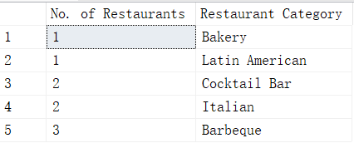
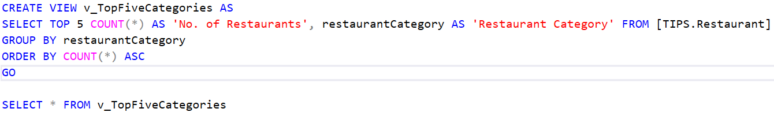
What are the top 5 categories with the least number of restaurants

Slide 25
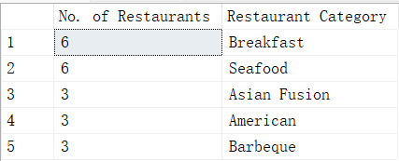
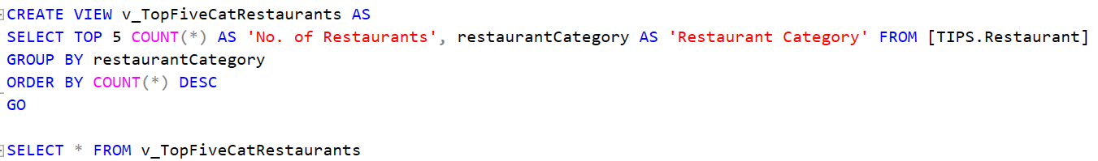
What are the top 5 categories with the most number of restaurants

Slide 26
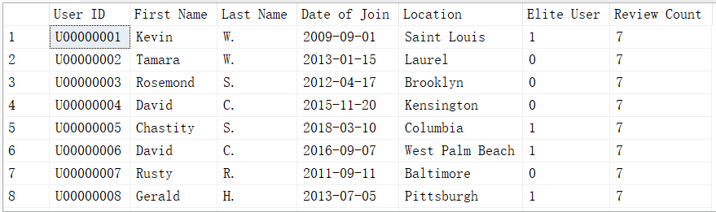
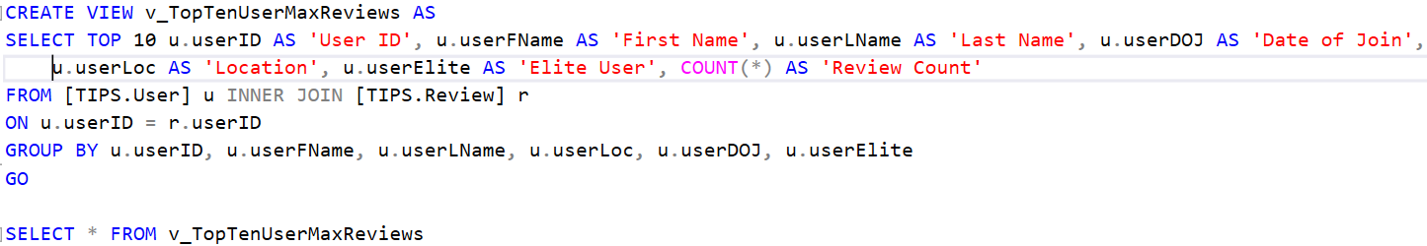
What are the top 10 users who have posted the maximum number of reviews. We also display the elite users.

Slide 27
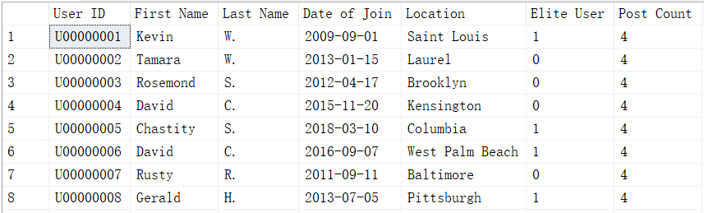
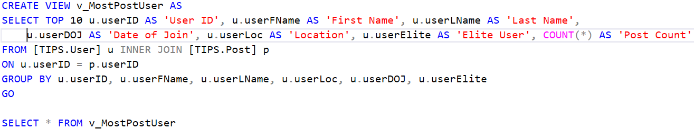
What are the top 10 users who have posted the maximum number of posts. We also display the elite users.

Slide 28
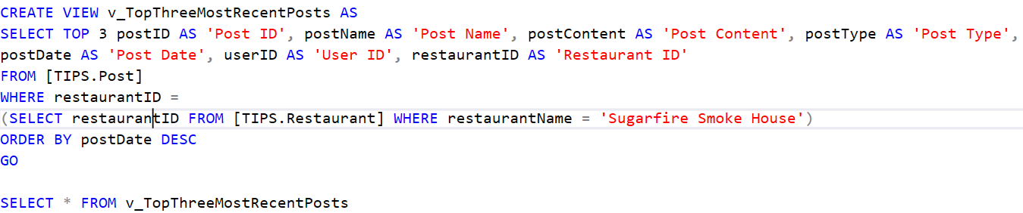
What are the top 3 most recent posts for a chosen restaurant

Slide 29
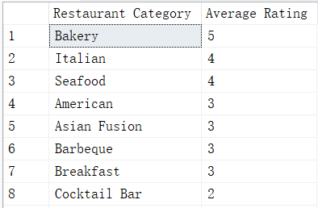
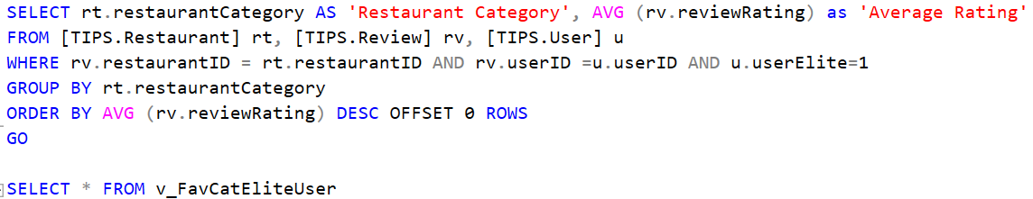
What are the favorite restaurant categories for elite user in descending order

Slide 30
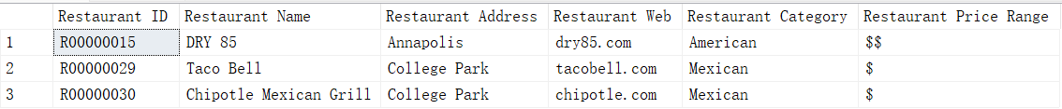
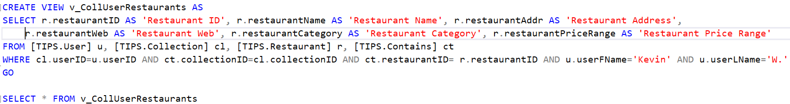
What are the restaurants in the collection of a chosen user. In this case, we have chosen Kevin W. as the user

Slide 31
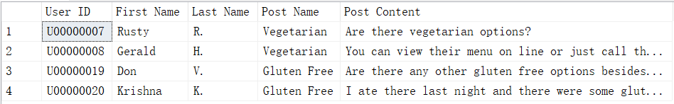
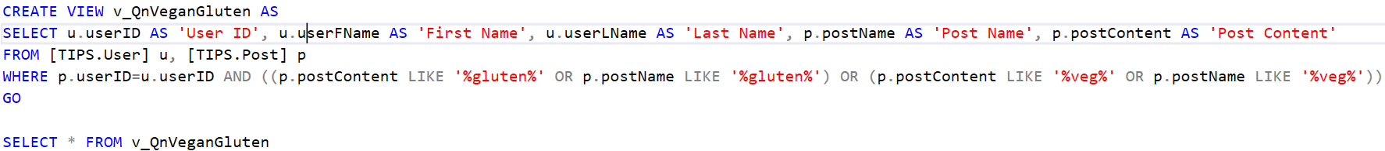
Who are asking or answering questions about vegetarien(vegan) or gluten

Slide 32
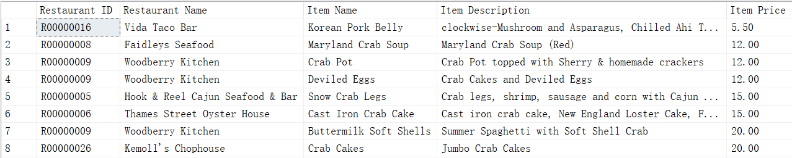
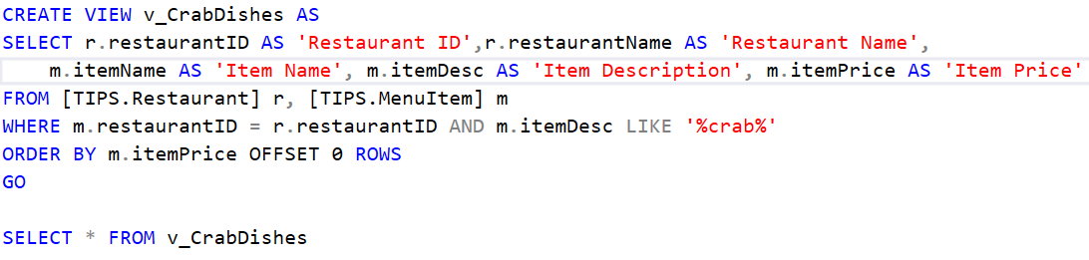
Find all crab dishes and rank all crab dishes by price from low to high

Slide 33
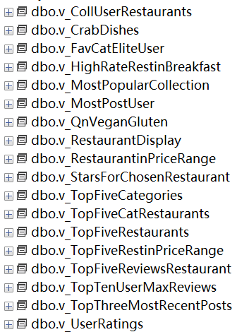

Slide 34
Thank you!

